Slide 1
ZS Campus Beats 2021 Case Challenge

Slide 2
Scenario one (BUSINESS CONSULTING)

Slide 3
BACKGROUND
Pulse Beverages is a leading nutrition drink manufacturer and seller in the US. The company introduced its unique drink Aqua few years ago which is now well established in the market.
Aqua currently comes in ready to drink packaging, in bottles of 500 ml and in a variety of three flavors.
Although Aqua’s revenue continues to grow, the company is getting increasingly concerned about rising marketing costs and the marketing team at Pulse Beverages is under pressure to not increase promotional costs further while still ensuring that Aqua,’s growing revenue trend continues and customer satisfaction remains high.

Slide 4
Effective Promotions and channel strategies
Identifying optimal promotional channels
Effectiveness of Promotion channels
Background
Pulse beverage has been using various challenges to promote Aqua.
The company has captured historical data pertaining to promotion of Aqua along with the impact on sales from each channel.
The company has also received results from a market research which talks about channel accessibility and popularity rating.
Revenue
(Promotion Impacted Sales)
Cost of promotional channel
Promotion Impacted Sales = 35% of Total Sales = 700 million USD
Promotional Budget = 100 Million USD
TV Ads
Print Ads
Social Media
Events
Website Display

Slide 5
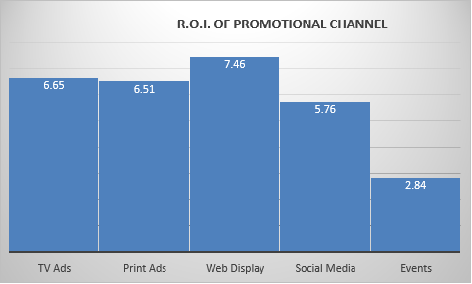
Here, Cost of promotion is valid if we utilise till threshold of our promotional budget .i.e., 100 million USD.
PROMOTIONAL CHANNELS | PERCENTAGE OF PROMOTION SALES IMPACT (%) | REVENUE THROUGH EACH CHANNEL (In Mil. USD) | COST OF PROMOTION (In Mil. USD)
TV Ads | 25 | 245 | 32.01
Print Ads | 25 | 175 | 23.28
Web Display | 17 | 119 | 14.55
Social Media | 15 | 105 | 15.52
Events | 08 | 56 | 14.55
(Refer to Table-1)

Slide 6
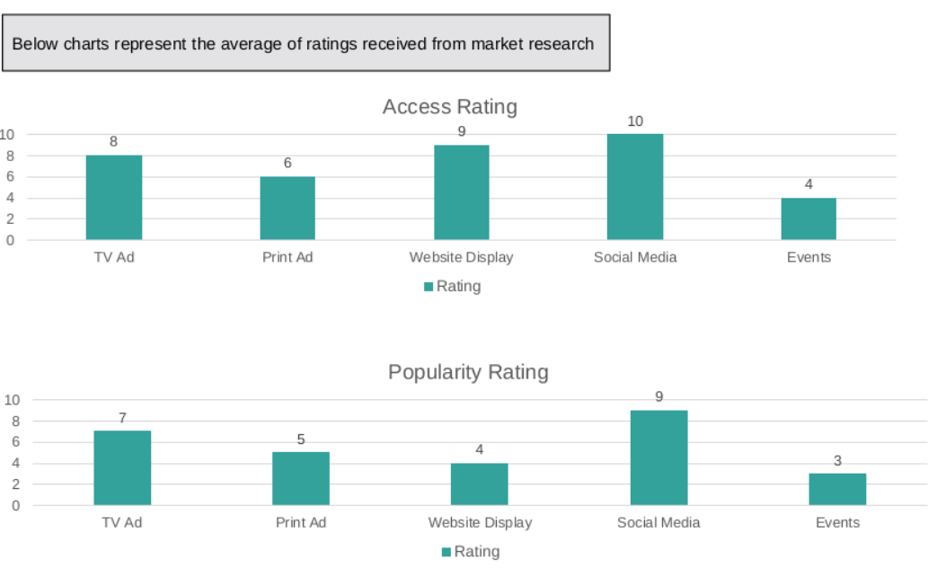
ACCESSIBILITY AND POPULARITY OF CHANNELS

Slide 7
PROBLEM STATEMENT
Q.1.1) What priority of channels will you recommend for future promotion ?
According to R.O.I. , we should go forward with these promotional channels –
TV Ads
Print Ads
Web Display
Social Media
Q.1.2) Pulse Beverages conducted a market research to understand channel accessibility and popularity. Based on this data,
b) Which things will you keep in mind in designing the content for chosen channels based on new normal post COVID scenarios ?
TV Ads- Emphasis on immunity boosting qualities of the drinks.
Messages on awareness and the efforts made by the brand in helping the people fight the difficult time.
Web Display- Messages of solidarity and encouragement.
Web Display is a channel not visible to the entire clientele, so ads specific to the demographic can be placed.
Social Media- Use the latest trends and designs of content being consumed to spread the message across.
Which three channels would you pick considering outcomes from both Q.1.1 AND Q.1.2?
According to R.O.I and Accessibility and Popularity charts, following channels should be picked –
TV Ads
Web Display
Social Media

Slide 8
Accessing TV campaign and customer preferences
YEARLY SALES ( 2 Bil. USD)
BACKGROUND
To improve overall sales, Pulse Beverages plans to launch new TV Commercials and reach out to certain customer segments. However, the company has budget to air the commercials in only one of the regions and not nationally.
Alongside they also want to make sure that the aired advertisement ensures maximum impact and engagement
Region 1
Region 2
Region 3
800 Mil. USD
Out of 1270 Mil. USD
560 Mil. USD out of 667 Mil. USD
640 Mil. USD out of 1067 Mil. USD
(Revenue generated by company VS Total market revenue )

Slide 9
REGION | RELEVANT POPULATION | ACTIVE CUSTOMERS | TARGET CUSTOMERS(THROUGH ADVERTISEMENTS) | MARKET SHARE (REVENUE)(%)
1 | 54230 | 34707 | 19523 | 63
2 | 92800 | 36192 | 56608 | 84
3 | 86400 | 29376 | 57024 | 60

Slide 10
SEGMENT 1:
Engaged during TV Series, Sports Events and Movies.
Engagement w.r.t. music: Engaged more without upbeat music.
Engagement w.r.t. length of ad: Engaged most with shorter ads.
CONCLUSION
Cost of Ads Without Upbeat Music During TV Series : $ 200, duration of ad is 90 seconds.
Cost of Ads Without Upbeat Music During Sports Events : $ 450, duration of ad is 90 seconds.
SEGMENT 1 WOULD ENGAGE MOST WITH ADS DURING TV SERIES, WITHOUT UPBEAT MUSIC, DURATION OF 90 SECONDS, AT TIME 7:00 PM TO 10:00 PM.

Slide 11
SEGMENT 2
Engagement w.r.t ads aired during shows: Engaged only during Sports Events.
CONCLUSION:
LEAST COSTLY AD DURING SPORTS EVENTS :
$400 AIRED BETWEEN 7:00PM TO 10:00PM
$400 AIRED BETWEEN 5:00PM TO 7:00PM
SEGMENT 2 WOULD ENGAGE MOST IN SPORTS EVENTS AD AIRED BETWEEN 7:00 PM TO 10:00 PM (peak time of tv viewership).

Slide 12
SEGMENT 3:
SEGMENT 3 SHOWED THE MOST ENGAGEMENT.
Engagement w.r.t ads aired during shows: Engaged most during TV shows.
Engagement w.r.t. music: Engaged more with upbeat music.
CONCLUSION
Cost of ads for TV series with Upbeat Music: $200, with a duration of 90 seconds, aired between 7:00 PM to 10:00PM, the peak time of TV viewership.
SEGMENT 3 WOULD ENGAGE MOST WITH THE ABOVE AD.

Slide 13
SEGMENT 4:
Segment 4 showed the least Engagement.
Engagement w.r.t ads aired during shows: Engaged with ads during sports events and cartoon.
Engagement w.r.t. length of ad: Engaged most with shorter ads.
CONCLUSION
SEGMENT 4 SHOWS MOST ENGAGEMENT WITH ADS AIRED DURING CARTOONS, FROM 10:00PM TO 11:59 PM WITH UPBEAT MUSIC AT A COST OF $600.

Slide 14
ONE ADVERTISEMENT TO BE AIRED:

Slide 15
PROBLEM STATEMENT
Q.2.2) Using the historical engagement data, identify which advertisements would each customer segment engage with. Recommend one advertisement to be aired broadly.
ONE AD TO BE AIRED BROADLY MUST BE : A 60 SECOND AD PLAYED DURING SPORTS EVENTS, DURING 7:00PM TO 10:00PM. (Peak time of TV viewership)
THE COST OF AD IS $800 WITH UPBEAT MUSIC.
Q.2.1) Based on current sales by region, identify the maximum opportunity and suggest a region to invest in for the TV campaign ?
Region 2 and Region 3 have the same potential to generate revenue through sales.
Region 2 holding 84% market share
Region 3 holding 60% market share
High market share can lead to low marketing costs.
Higher word-of-mouth comes into picture.
Established and more diversified networks.
As market share rises, turnover on investment rises only somewhat, but profit margins on sales increase sharply.
Purchase to sales ratio will get improved.
Q.2.3) Pulse has also planned to launch a new product(Aqualite) along with the current drink. Based on your current understanding and analysis, what promotional strategies would you recommend for the new product in terms of :
Types of product – A particular demographic can be targeted who might be more likely to use the product.
Channels for promotion – Even though print ads and web display have a higher R.O.I. they have a lower visibility which is not feasible with the launch of a new product. Social media proved to have a higher popularity rating and must be the key channel for promotion.
Segment of customers – Various segments engage differently with different ads. Customers broadly engage more with ads during peak tv viewership hours.
Content& Messaging – With the wide popularity of social media and trends thereof, content in accordance to those have a higher probability of catching the eye of potential consumers.

Slide 16
ALLOCATING THE PROMOTIONAL BUDGET OPTIMALLY
BACKGROUND
Pulse Beverages has decided to reduce its total promotional budget for the current year to 50 Mil. USD.
Based on the historical activity and the revenue generated, the promotion response for the various activities has been given.
Pulse Beverage has historically invested in 5 promotional channels which cater to customers.

Slide 17
(Refer to Table-2 ROI)

Slide 18
PROBLEM STATEMENTS
Q.3.1) What should be the optimal promotional spend on the various channels? Out of the 5 channels listed on the next slide, Pulse wants to spend the promotion budget on 3 channels only, so the optimal spend should be calculated for 3 out of 5 channels.
These are chosen according to their R.O.I at their specific promotion costs :
TV Ads(4 million USD)
Web Display(40 million USD)
Print Ads(6 million USD)
Q.3.2) What would be the maximum revenue that Pulse Beverages can make using the 50 million USD promotional budget ?
According to the optimal promotional budget which include three separate channels for advertising. It is –
TV Ads – 20 Million USD
Print Ads – 35 Million USD
Web Display – 200 Million USD
Total= 255 Million USD
Q.3.3) Given the budget allocation in previous question and based on the additional data in slide 12, should the company change its strategy of not using a certain channel to target a specific segment?
With the passage of time, print media continues to be obsolete. With a large demographic moving away from it, if additional channels are not employed, brand visibility in media will be an issue.
In case multiple strategies are used, the probability of capturing the attention of new clients improves greatly.
So the company must keep employing the strategy of not using a certain channel to target a specific segment.

Slide 19
OBJECTIVE QUESTIONS
What is the total promotional impacted sales from the bottom two channels(with lowest share of impacted sales)?
161 Million USD
What is the ROI in one decimal for the three channels in the optimal promotion split?
(5+5.833+5)/3=5.28
What is the difference between the maximum revenue based on optimal promotional split and the maximum revenue that could be generated if there was no constraint on the number of promotional channels?
(300-255) Million USD = 45 Million USD

Slide 20
THANK YOU

